Slide 1

Team Details
Team Name: GreenSapio
Team Leader Name: Tarun Sharma
Problem Statement: Burning of Agriculture Waste Rice Straw (Parali) in North India leading to Air Pollution, Impacting Health, Environmental Degradation and Economic Losses

Slide 2

Burning of Rice Straw (Parali)
Health Impact: The smoke from burning Rice Straw contains contains numerous toxic chemicals and fine particulates that can penetrate deep into the lungs, causing respiratory problems such as asthma, bronchitis, and aggravated for people with pre-existing respiratory ailments, Prolonged exposure to such air pollutants can also lead to long term health issues.
Environmental Degradation: The burning of Rice Straw not only releases greenhouse gases like carbon dioxide (CO2) but also contributes to local environmental degradation. It reduces soil fertility and microbial activity, adversely affecting soil health and agriculture production over time.
Air Pollution: Burning of Rice Straw releases harmful pollutants such as particulate matter (PM10 and PM2.5), carbon monoxide (CO), sulfer dioxide (SO2), and nitrogen oxides (Nox) into the atmosphere. These Pollutants contribute to poor air quality, especially during the post harvest months (October – November), exacerbating respiratory illness and reducing visibility.

Slide 3
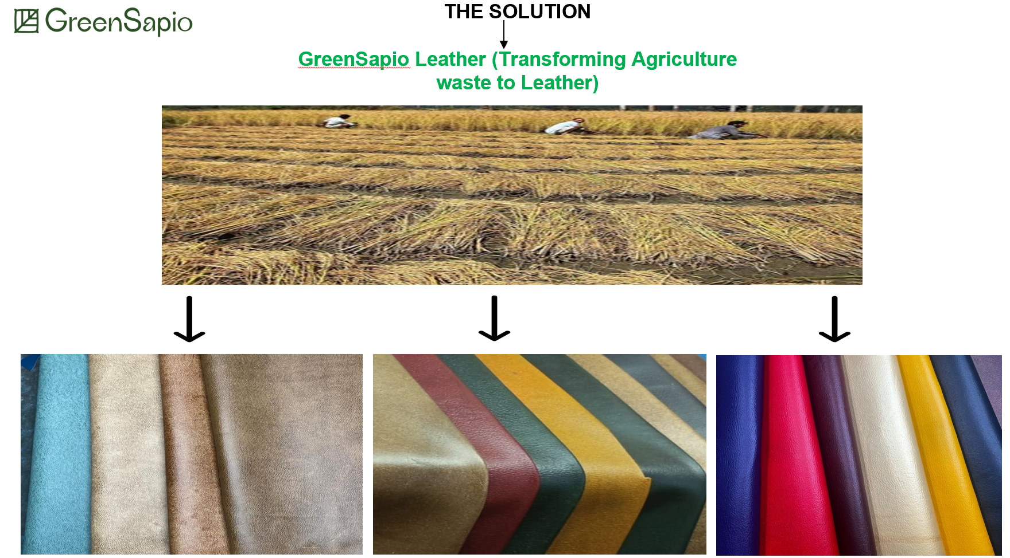

Slide 4
Opportunities
How different is it from any of the other existing ideas?
Currently in India, companies are making leather from other agriculture waste like Cactus, Banana Stems and Pineapple leaves however no company is making leather from Rice Straw (Parali). Therefore these will be first mover advantage.
How will it be able to solve the problem?
We will buy Rice Straw from Farmers generating additional income stream and convert this waste to Innovative Alternative Leather Sheets and Products like Ladies Bags, Laptop Bags, Luggage Bags, Other Leather Bags, Leather Jackets, Leather Pants, Belts, Wallets, Diaries etc.
USP of the proposed solution
GreenSapio Leather will contain 97% plant based material
Zero Liquid Discharge Manufacturing Process
20% cost v/s similar animal leather product
10 years durability

Slide 5
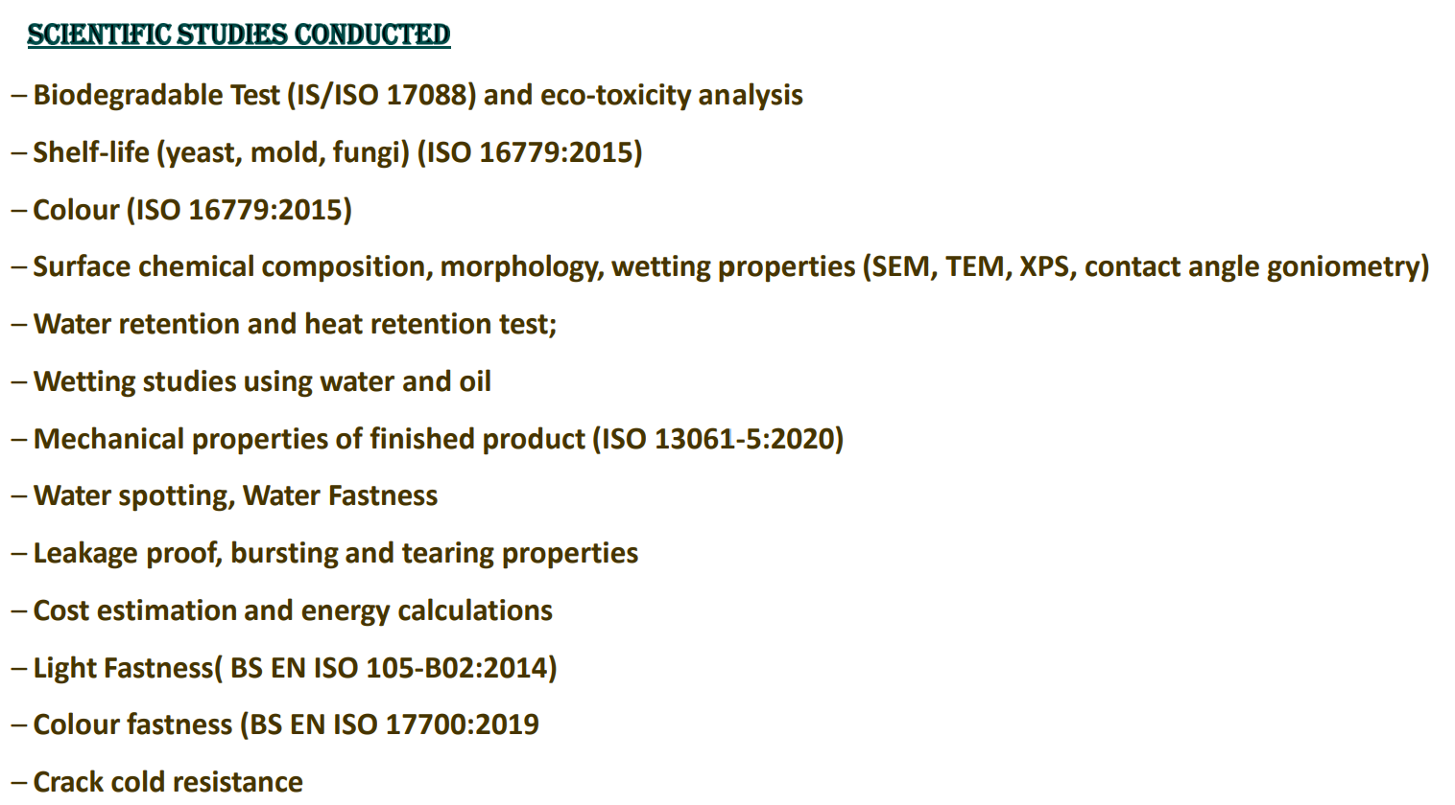

Slide 6
List of features offered by the solution
Mechanical Properties of GreenSapio Leather v/s Synthetic Leahter & Animal Leather
Samples | Synthetic leather | Animal leather | Rice Straw & Wheat Straw Leather
Tensile Strength (MPa) | 8.2 – 11.5 | 13.1 – 24.0 | 17.1
Max Force (N) | 60 – 80 | 80 – 100 | 95
Elongation (%) | 11 – 50 | 20 – 90 | 74
Stress at Break (N) | 20 – 50 | 30 – 85 | 72
Force at Break (N) | 20 – 60 | 50 – 100 | 71
Thickness (mm) | 0.60 – 0.80 | 0.40 – 0.80 | 0.65
Width (mm) | 15 – 30 | 15 – 35 | 40
Shrinkage (%) | 5 – 25 | 3 – 30 | 26

Slide 7
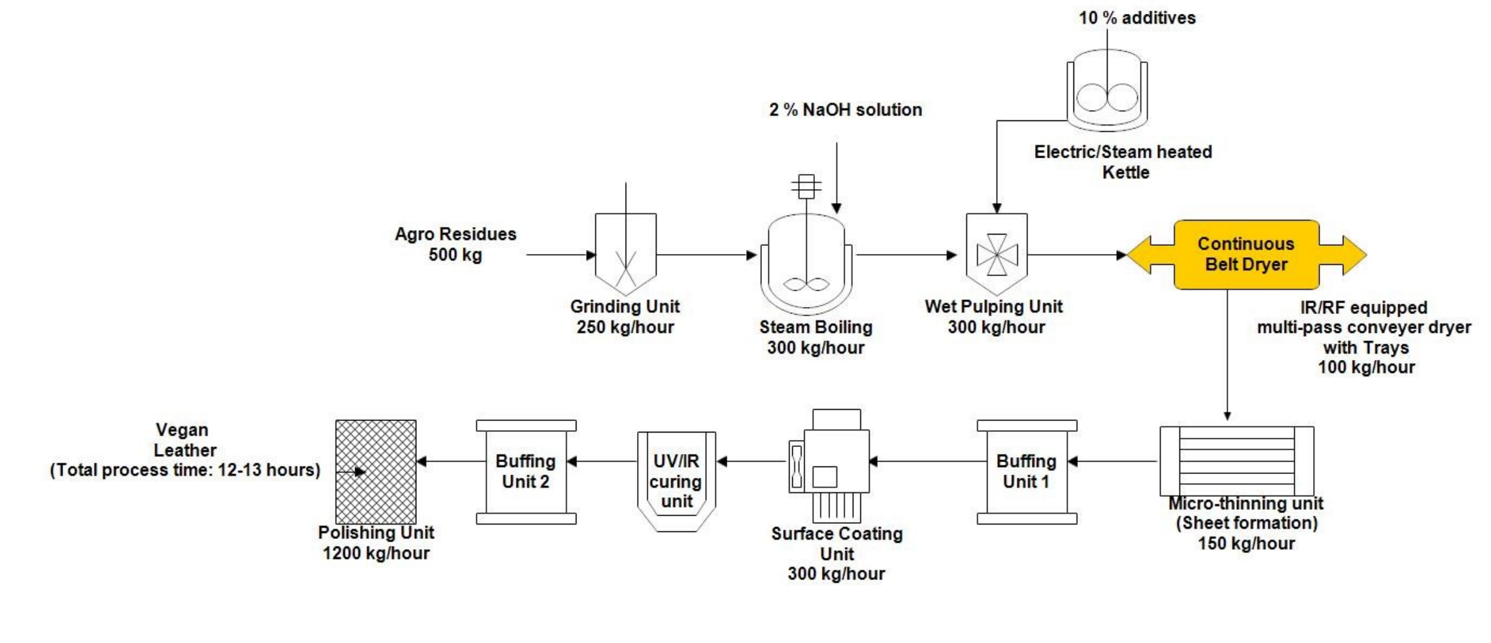
Process flow diagram or Use-case diagram

Slide 8
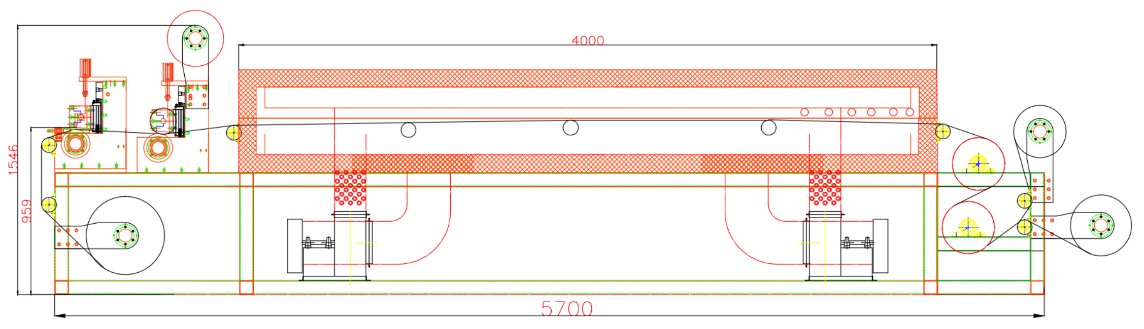
Architecture diagram of the proposed solution

Slide 9
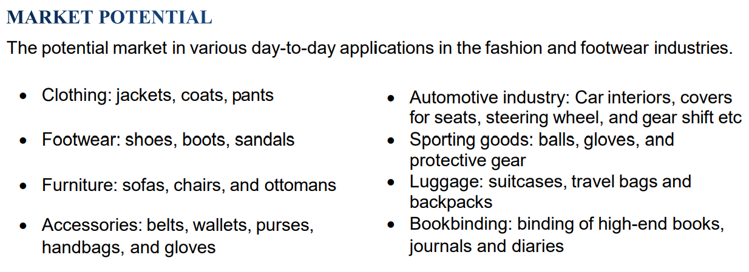
Technologies to be used in the solution

Slide 10
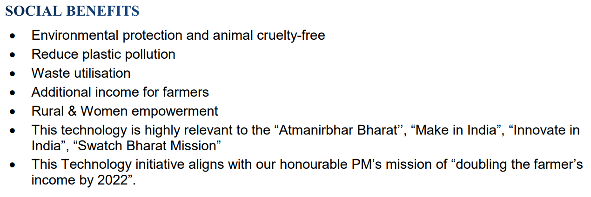

Slide 11
Estimated implementation cost (optional)

Slide 12
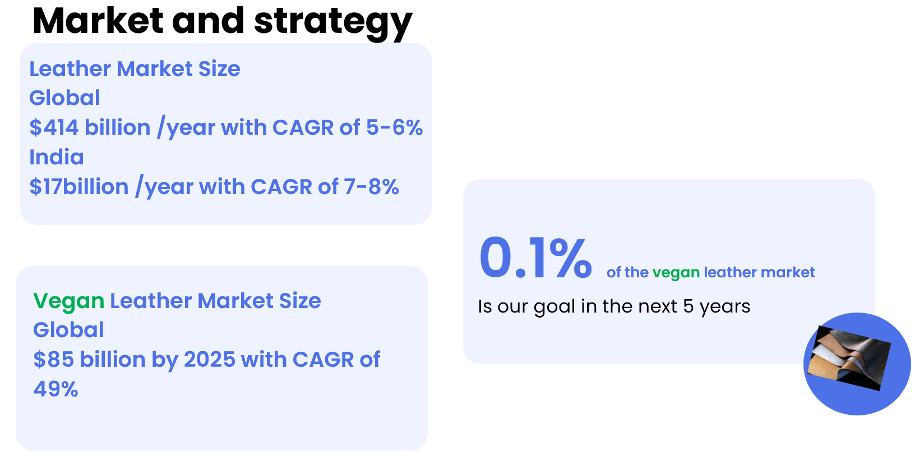

Slide 13
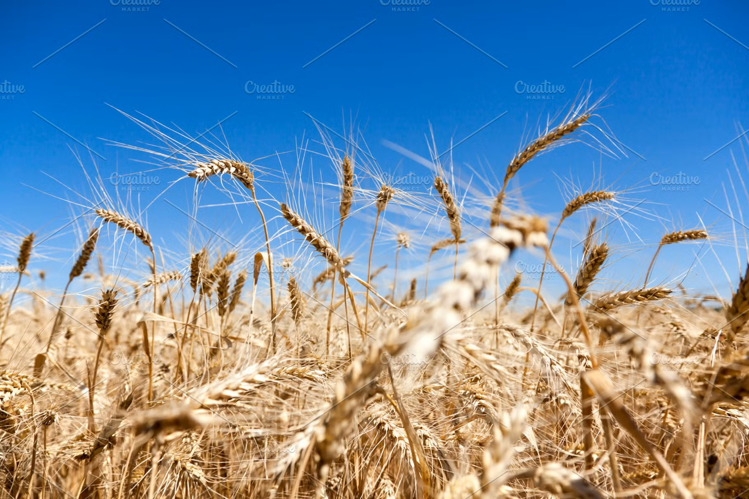
Our Advantages
GreenSapio
Our product, vegan leather crafted from wheat or rice husk in North India, is an ethical, eco-friendly and affordable alternative. Utilizing agricultural waste fosters local innovation, feeds the growing demand for sustainable fashion, and propels a circular economy.
We are entering in Agreement with three big farmers of Haryana & Punjab to continuously supply Rice Straw & Wheat Straw throughout the year
17

Slide 14
Founder Team
Mr. Vasan Sai, Mentor
(Leather Expert - 4 decades of experience in Leather Industry)
Tarun Sharma, CEO
(Chartered Accountant 14 years of Business Management Experience)
Shikha Pandey, CFO
(Chartered Accountant – 10 years of CFO experience)
Arun Sharma, Operations Head
(Chemical Engineer – 8 years of Business Experience)
12

Slide 15

Progress for 10 months
We've successfully completed our research and development phase to produce vegan leather from Rice & Wheat Straw (Parali). Currently, we're in the midst of setting up our manufacturing facility in Jhajjar, Haryana, India to initiate production.
18

Slide 16
GitHub Public Repository Link & Demo Video Link
https://www.youtube.com/watch?v=ir6axmz3Q1w

Slide 17


